Slide 1

DEPARTMENT OF COMPUTER SCIENCE AND ENGINEERING
HEALTH MONITORING SYSTEM
PROJECT STUDENT MENTOR
Siddhika Seth, 43111306 Dr. J Cruz Antony,MCA.,Ph.D.,
Bharat P, 43111298 Associate Professor
Srinadhu Madhumathi, 43111296
Ambarapu Humayun Basha, 43111304
Manadava Sree Harshith, 43111327
Sai Manikanta Praveen, 43111292

Slide 2
INDEX
Abstract
Objective
Problem Definition
Ideation
Introduction
Existing Model
Proposed Model
Requirements
Design Diagram
Working Features
Applications
Conclusion
References

Slide 3
ABSTRACT
The IoT Based Health Monitoring System is designed to provide continuous, real-time monitoring of vital health parameters using modern electronics and communication technologies. The system employs an NodeMCU ESP8266 as the central controller, interfaced with a MAX30102 pulse oximeter and DS18B20 digital temperature sensor to gather biometric data such as heart rate, oxygen saturation, and body temperature. These parameters are instantly displayed on a local RGB LCD shield for the user and simultaneously transmitted via the ESP8266 Wi-Fi module to the cloud platform ThingSpeak, enabling remote access and real-time analytics. The project addresses the limitations of traditional health monitoring systems by offering portability, automation, and remote monitoring capabilities, making it highly applicable in home healthcare, rural clinics, and emergency response scenarios.

Slide 4
OBJECTIVE
To provide a cost-effective and portable alternative to traditional hospital-based monitoring systems, making it suitable for use in rural and home environments.
To visualize patient health trends over time through online dashboards (e.g., ThingSpeak), helping doctors make data-driven decisions.To ensure user-friendly interaction by displaying real-time readings on an LCD screen for patients and caregivers.
To explore the integration of additional sensors (e.g., blood pressure, ECG, motion detection) for expanding the system's capabilities in future versions.
To ensure data integrity and reliability through proper testing, calibration, and comparison with standard medical devices.

Slide 5
PROBLEM DEFINITION
Current health monitoring systems either require hospital-grade machines or involve manual processes which are time-consuming and inaccurate.
Inability to remotely monitor patient data delays medical intervention.
A lack of integration between sensors, data transmission, and remote accessibility creates inefficiencies in health services.
There is a strong need for an automated, IoT-based system that can provide accurate and timely health updates.

Slide 6
IDEATION
Develop a modular and scalable system using cost-effective sensors and microcontrollers.
Integrate wireless data transmission using ESP8266 Wi-Fi module to connect to a cloud server.
Use an LCD display for local feedback to the patient.
Visualize and analyze data using online platforms (ThingSpeak) to monitor trends and share data with healthcare professionals.

Slide 7
INTRODUCTION
The Health Monitoring System is an IoT-based project designed to measure and display key health parameters such as body temperature, heart rate, and oxygen saturation (SpO2). The system utilizes NodeMCU ESP8266 as the central controller, interfacing with various sensors to collect real-time health data. The measured values are displayed on a 16x2 LCD screen with an I2C
interface, and the ESP8266 Wi-Fi module allows remote data transmission for further analysis and telemedicine applications.

Slide 8
EXISTING MODEL
Manual/Wired Systems: In-person monitoring using paper-based records or wired equipment. Limited mobility and no remote tracking capability.
Early Electronic Systems: Used within hospitals; provided basic electronic readings but lacked internet connectivity or remote access features.
Early Digital Systems: Introduced digital sensors with some portability, but lacked reliable wireless data transmission or cloud integration.
Early Wearables: Wearable devices began storing health data locally (e.g., on the device), but had limited options for real-time remote access or analysis.

Slide 9
PROPOSED MODEL
A portable and wireless health monitoring system using NodeMCU ESP8266, sensors.
It collects heart rate and body temperature data and transmits it to a cloud platform (likely ThingSpeak, based on the code snippets) for remote monitoring and analysis.
The system is intended to be low cost and easy to implement.

Slide 10
REQUIREMENTS
Hardware:-
DS18B20 Digital Temperature Sensor Module - a digital temperature sensor with a single-wire interface and high accuracy.
MAX30102 Pulse-Ox & Heart Rate Sensor - Monitors heart rate and SpO2 levels.
16x2 LCD Display with I2C Interface - Displays real-time health data.
NodeMCU ESP8266 Wi-Fi Module - Enables remote monitoring via IoT.
Jumper Wires.
Software:-
Arduino IDE
ThingSpeak account (or similar IoT platform)
Libraries for the sensors and ESP8266.

Slide 11
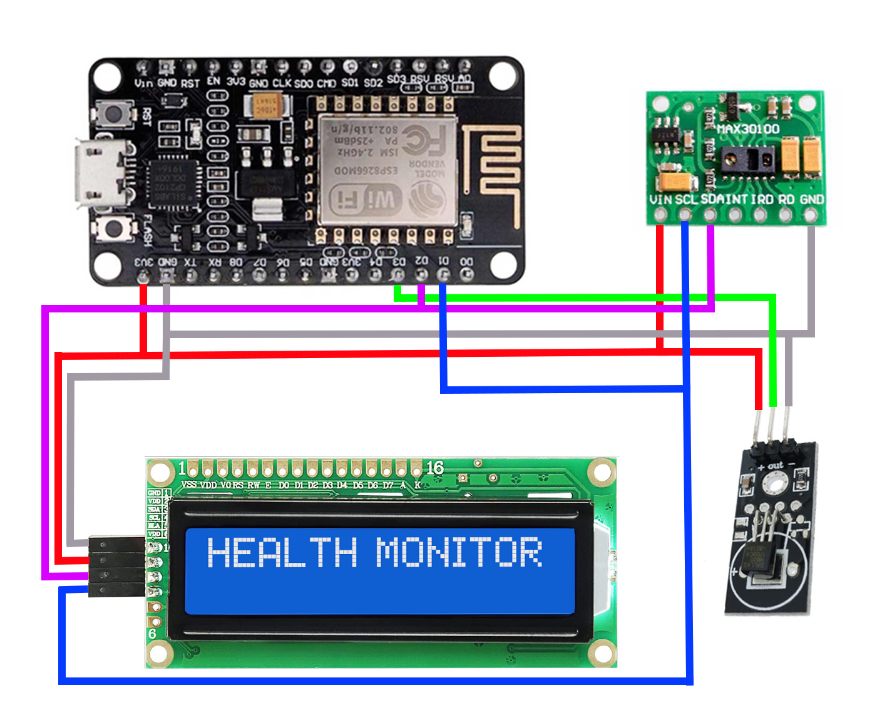
DESIGN DIAGRAM
MAX10302
ESP8266
LCD
LS18B20

Slide 12
WORKING FEATURES
Heart Rate Monitoring: The pulse sensor measures the user's heart rate, and the ESP8266 processes the data.
Temperature Monitoring: The DS18B20 sensor measures the user's body temperature, and the ESP8266 processes the data.
Data Transmission: The ESP8266 Wi-Fi module transmits the sensor data to the ThingSpeak cloud platform via the internet.
Remote Monitoring: The data can be viewed and analyzed remotely through the ThingSpeak web interface or mobile app.
Real-time data: The system sends data at regular intervals.

Slide 13
APPLICATIONS
Used in hospitals for monitoring multiple patients simultaneously.
Ideal for home use by elderly individuals or patients under long-term care.
Helpful in rural and remote regions with limited access to hospitals.
Can be adapted for sports and fitness tracking.
Supports research by collecting health data over long periods.

Slide 14
CONCLUSION
In conclusion, IoT enhances healthcare by enabling real-time monitoring, early diagnosis, and quicker response times. This project leverages sensors, NodeMCU ESP8266, and Wi-Fi connectivity to create a smart, user-friendly health monitoring system that improves patient care and healthcare efficiency.

Slide 15
REFERENCES
Rajesh Jiet. "IoT Based Health Monitoring System." Arduino Project Hub. https://projecthub.arduino.cc/rajeshjiet/iot-based-health-monitoring-system-arduino-project-27f2ba
Arduino.cc, ThingSpeak.com, and respective sensor datasheets.
Sharma, A., & Yadav, R. (2021). IoT-Based Smart Health Monitoring System: Design and Implementation. International Journal of Engineering Research & Technology (IJERT), Vol. 10 Issue 05.

Slide 16
THANK YOU
We thank God, Our Department, Guide, Panel Members, Supportive Professors and all Technical and non Technical staff who helped us in our Project.

